Slide 1
Plano Photography Club
Lightroom 1
Overview, Library, Basic Editing
Dennis Fritsche
February 7, 2015

Slide 2
Purpose of the Two Part Course
Goal for Introduction Class: (Day 1) Learn what Lightroom is and the function of the Modules. Learn the concept of a Catalog and how it differs from a browser and from a file structure. Understand the operation of the Library Module. Be able to import photographs into the Catalog. Understand the basic tonality adjustments in the Develop Module. Learn where to go for help.
Goal for Image Processing Class: (Day 2) Understand how to use the global and local tools in the Develop Module. Understand the time savers – presets, sync and auto sync. Learn where to go for help. Learn to export to jpeg and tiff and to print.
After these two sessions, you should be able to decide if Lightroom is for you and should be able to start using it.
You will not be proficient and you will have to practice, practice, practice.

Slide 3
What is Lightroom?
Adobe ® Photoshop® Lightroom® 5 software provides a comprehensive set of digital photography tools, from powerfully simple one-click adjustments to cutting-edge advanced controls. Create images that inspire, inform, and delight. – Adobe
Lightroom is “photo central” for photographers of all levels and provides powerful but easy to understand tools from import and management, to adjustments, to output to print, the web, slideshows, mapping, and books. – Dennis
Lightroom is highly integrated with external editing programs and third party plugins.

Slide 4
Why Should You Use Lightroom?
Lightroom was built from the ground up for photographers and some of the best people in the post processing world contribute.
The processing engines are world class.
It is non-destructive. Your RAW files are never changed.
To me, it is very straight forward.
One spot to do just about everything – more and more I don’t go to Photoshop other than a convenient way to apply my favorite NIK Software (now Google) filters or to combine images.
Presets!

Slide 5
How is Lightroom different from your editing program?
Lightroom handles many tasks in addition to adjusting your images – cataloging, outputting, etc.
Lightroom is primarily aimed at making global adjustments to your images – tonality, color, sharpening, noise reduction, lens adjustments, with some powerful local adjustment.
Lightroom does not support layers or compositing and the cleanup tools are not as powerful as Photoshop.
In future training, others will show how Photoshop and Photoshop Elements works with Lightroom and how it does some of those things LR does not.

Slide 6
How is Lightroom better than your editing program?
Everything is processed in 16-bits with the biggest color space.
The data in the original file is never changed by LR.
There is no Open-Edit-Save.
For RAW shooters using Photoshop
Open RAW file in ACR
Process
Go to Photoshop
Save As – this file can be 10 X the size of the RAW file
For jpeg shooters using PS Elements or some other program.
Open jpeg
Process
Save – file has additional jpeg artifacts and your original file is gone
Or Save As - file has additional jpeg artifacts and your original file is preserved.
Every time you open and save the file, the data gets worse.

Slide 7
Major Parts of Lightroom
Library Module
Import images from your camera or card or computer
Add key words
View and change metadata
Rate images
Organize
Find images
Use Collections to make life easier
Develop Module
Make adjustments to your RAW and other images
Same controls as Adobe Camera Raw (ACR) but easier for me
Some local adjustments possible
Non-destructive adjustments
Use your preferred file organization
Map Module
Book Module
Slideshow Module
Print Module
Web Module

Slide 8
File Structure vs Catalog
File Structure
Where Your Actual Photos Are Stored
My Pictures
Lightroom Catalog
The Card File with Info about Your Photos
(Folder of) Miscellaneous Photos
(Folder of) Photos from 2011
(Folder of) 20110319 - Arboretum
(Folder of) 20110430 - Training
Lightroom Collections
Lists of different groupings of photos in the Catalog
(you may have collections that are used for a short time or are permanent)
(Folder of) Photos for Submittals

Slide 9
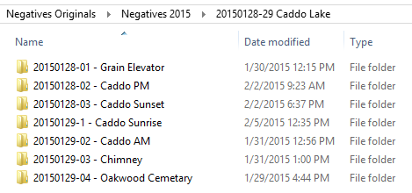
My Pictures on K:
3 TB
122,000 images
80 GB
57 GB for previews
20 GB for backups

Slide 10
Set LR Preferences Hands On

Slide 11
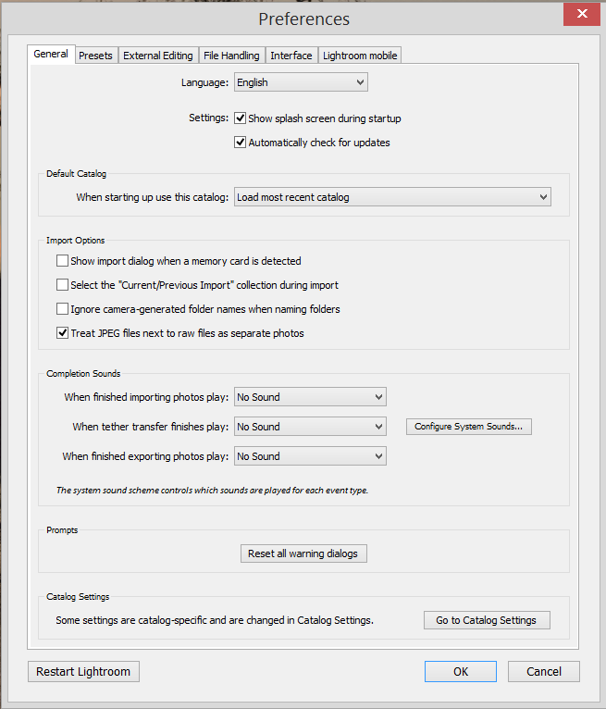

Slide 12
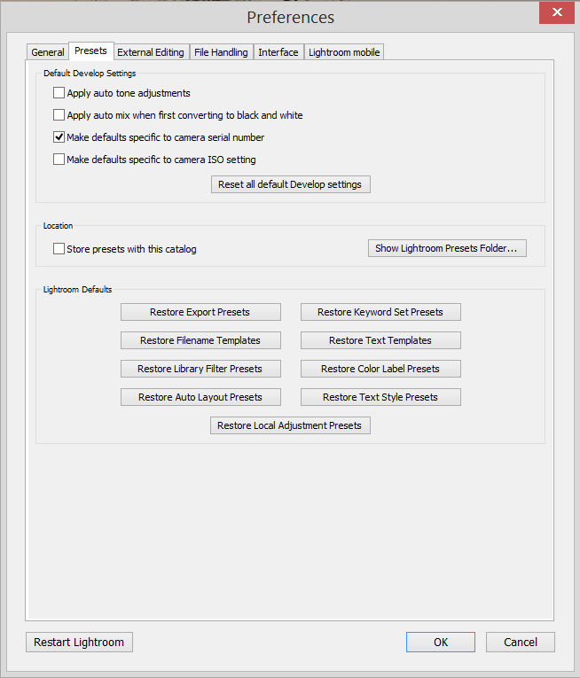
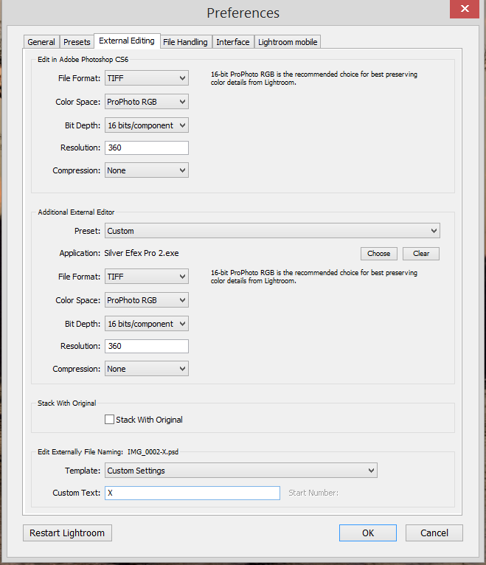

Slide 13
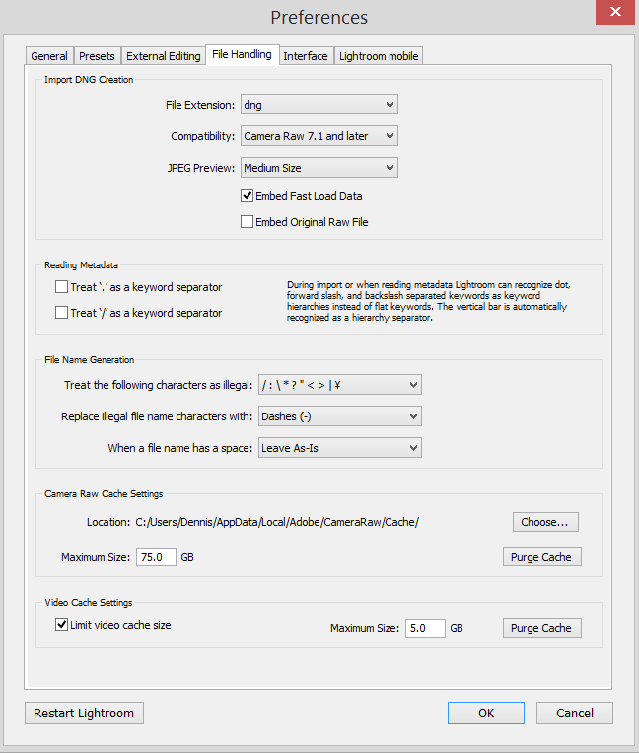
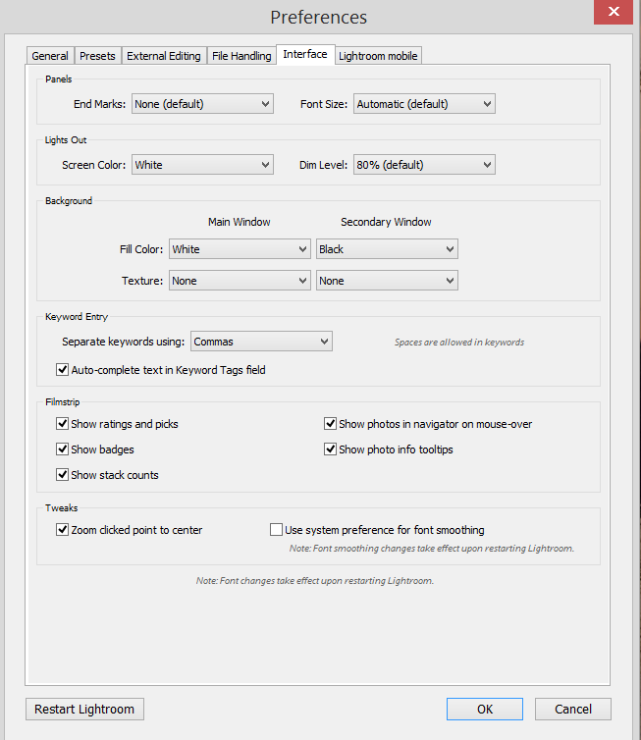

Slide 14
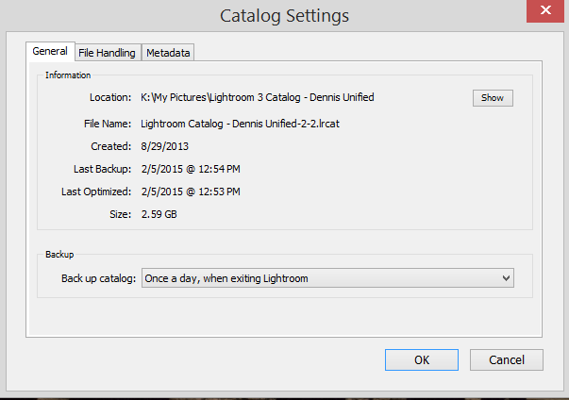
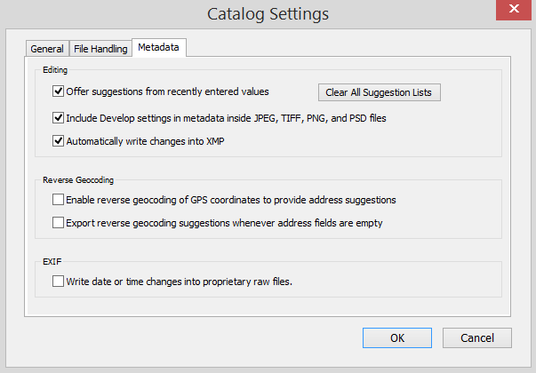
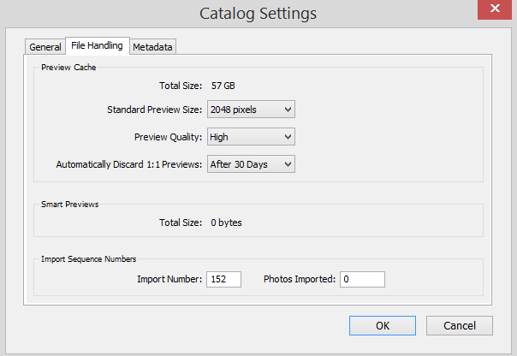

Slide 15
Exploring the Library Module
Help and Shortcuts
Left Panel for navigation and collections
Right panel – Quick Develop, Key wording and meta data
Film strip and navigation bar
Views
File sort order
Library Filter

Slide 16
Importing Images to the Catalog
Importing is a very unfortunate choice of words since it already has an established meaning which usually involves moving something.
Importing in the context of LR means “telling the catalog that you have new pictures and the catalog should learn where they are and remember them and keep track of the information associated with them”

Slide 17
Importing – The Less Confusing Way
People new to LR will be better off using this method
Use file manager to copy the images from your camera or memory card to your computer using your established folder/file structure.
Then open LR and ADD these new files into the Catalog
Done

Slide 18
Importing and Working in the Library Module Demo and Hands On
Import photos
Rename
Add Keywords
Examine EXIF data
Use the library filter

Slide 19
Importing – The More Powerful Way
As you gain experience use this method
Plug your camera or memory card into your computer.
Open LR and COPY new files into the Catalog and physically add the files to the established file structure
Rename
Add meta data
Demo

Slide 20
Exporting
Lightroom does not change your image file. It shows you a preview of what it will look like with the adjustments you have made.
That is why there is no “Save” or “Save As” button.
Exporting a file applies the adjustments and creates a new file with those adjustments applied in a different format.
You only need to export when you need a version of the image for a different purpose – for example to share with someone or to enter into a contest.

Slide 21
Exporting Demo and Hands On
Export a file for a club competition at a resolution of 1440 X 1050 in jpeg format and put it in a folder on the desktop called Temporary Images.
Make this a preset.
Export 5-10 files for a club field trip slideshow at a resolution of 1440 X 1050 in jpeg format, rename the files to include your name, the field trip name, and a sequence number, and put them in a subfolder under Temporary Images called Slideshow.

Slide 22
Deleting Images
Select the image(s) you want to delete.
Right click and chose “Remove Photo”
You have the option to
Delete from the disc and the catalog
Remove from the catalog and leave on the disc

Slide 23
Overview and Hands-On The Basic Panel of the Develop Module

Slide 24
Recommendations
Use one catalog. Having more than one catalog on your computer at a time will cause you to “misplace” photos and you will call me up and ask “what did LR do with my pictures”. They are probably in that other catalog
Start with just a few folders to see if LR is for you.
Once you commit to using LR, don’t move files and folders with anything other than LR!
Practice and study.

Slide 25
Resources On the Club Website http://www.planophotographyclub.com/members/training/ Requires login

Slide 26
Resources
Free
http://blogs.adobe.com/jkost/tag/the-develop-module
Pay
http://store.luminous-landscape.com/zencart/index.php?main_page=product_info&cPath=25&products_id=286
Outdoor Photographer, Dec 2014
Harness High Contrast by Michael Frye
http://www.michaelfrye.com/

Slide 27
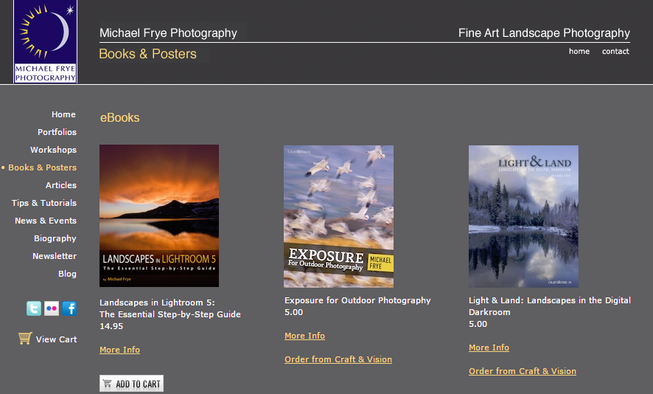

Slide 28
Thanks See you on February 28 for Lesson 2

